Slide 1
Come in Quietly
Concept
Take out a pen or pencil and your paper from yesterday.

Slide 2
Objective: Enumerate the Powers and Requirements of Congress.
Objective
Standard 8.2.6: Enumerate the powers of government set forth in the Constitution and the fundamental liberties ensured by the Bill of Rights.
WH 8.4: Produce clear and coherent writing in which the development, organization, and style are appropriate to task, purpose, and audience.

Slide 3
Prior Knowledge
Objective
You already know about checks and balances between the branches.
What does checks and balances mean?

Slide 4
Legislative Branch
Article 1
Concept

Slide 5

Legislative Branch
Article 1
Concept

Slide 6


Concept
¹Enumerated – named one after another in a list
Legislative Branch
Article 1
The Legislative Branch is also called Congress.
It is made up of two houses:
The Senate and the House of Representatives
The Enumerated¹ Powers of Congress are listed in Article 1, Section 8 of the Constitution.
Congress has the power to:
Make laws
Lay and collect taxes
Coin and Borrow money
Impeach and remove the President
Declare war
Pay debts and provide for defense
Establish post offices
Raise and support armies
Provide and maintain a Navy
Regulate commerce
Establish uniform naturalization
What powers did the Constitution give to the Legislative Branch?

Slide 7


Concept
Jeff Denham is the Ceres Representative to the House of Representatives
The House of Representatives
States with the largest populations have the most representatives in the House.
Representatives must be at least 25 years old to serve.
Representatives must be a citizen for at least 7 years.
Representatives must live in the state and district they are representing.
Representatives are elected to a two-year term.
There are 435 members in the
House of Representatives.
Why did the Constitution set the age for a Representative so young?

Slide 8



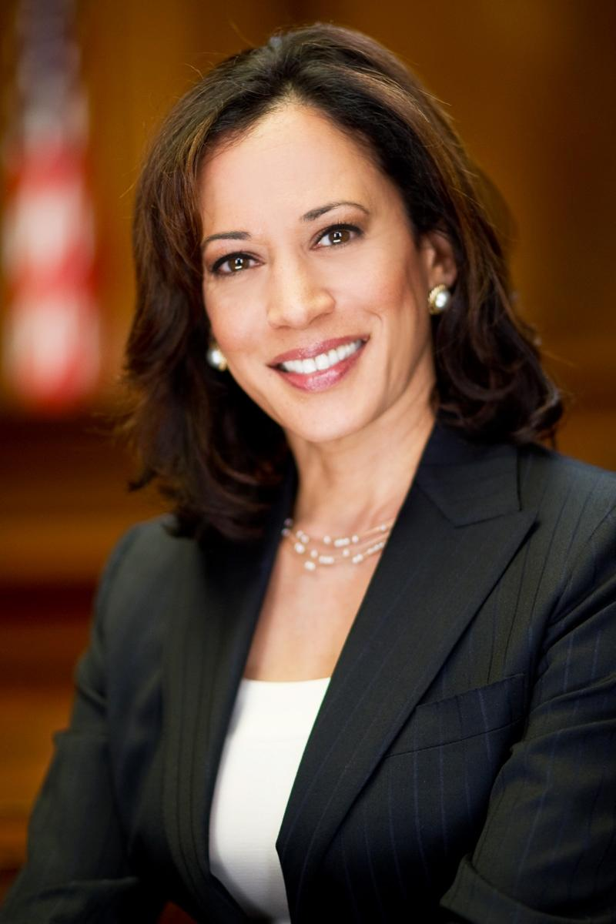

Concept
Why did the Constitution split the Legislative Branch into two parts?
The Senate
Senator-Elect Kamala Harris
The Senate is the other part of Congress.
There are two senators for each state, which means there are 100 Senators.
Senators must be at least 30 years old.
Senators must be a citizen for at least 9 years.
Senators must live in the state they are representing.
Senators are elected to a six year term.

Slide 9
Closure
What are the top 3 powers of the Legislative Branch?
What are the names of the two houses in Congress?
How many years does a Senator serve?
How many years does a Representative serve?

